Slide 1

User-Interface Design WUIV302
Lynette Barnard

Slide 2

Agenda
The process of interaction design (ID)
Check class list details

Slide 3
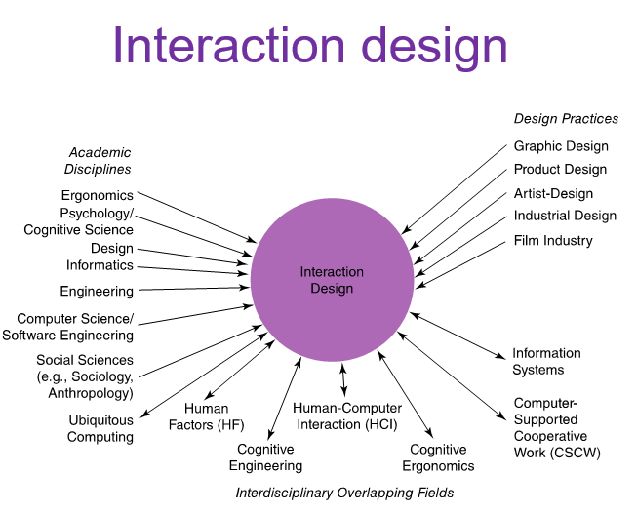
How do we design interactive products?
Different design fields / approaches; some commonalities
Focus on process of ID
ID focuses on activities to
discover requirements
design some artefact to meet requirements
produce prototypes (and evaluate)
Specifically consider users and goals (user-centred)
Who designing for (stakeholders; they’re not necessarily users)
User (not only technical) concerns direct development
Trade-offs – balance conflicting requirements

Slide 4

What is involved in ID?

Slide 5
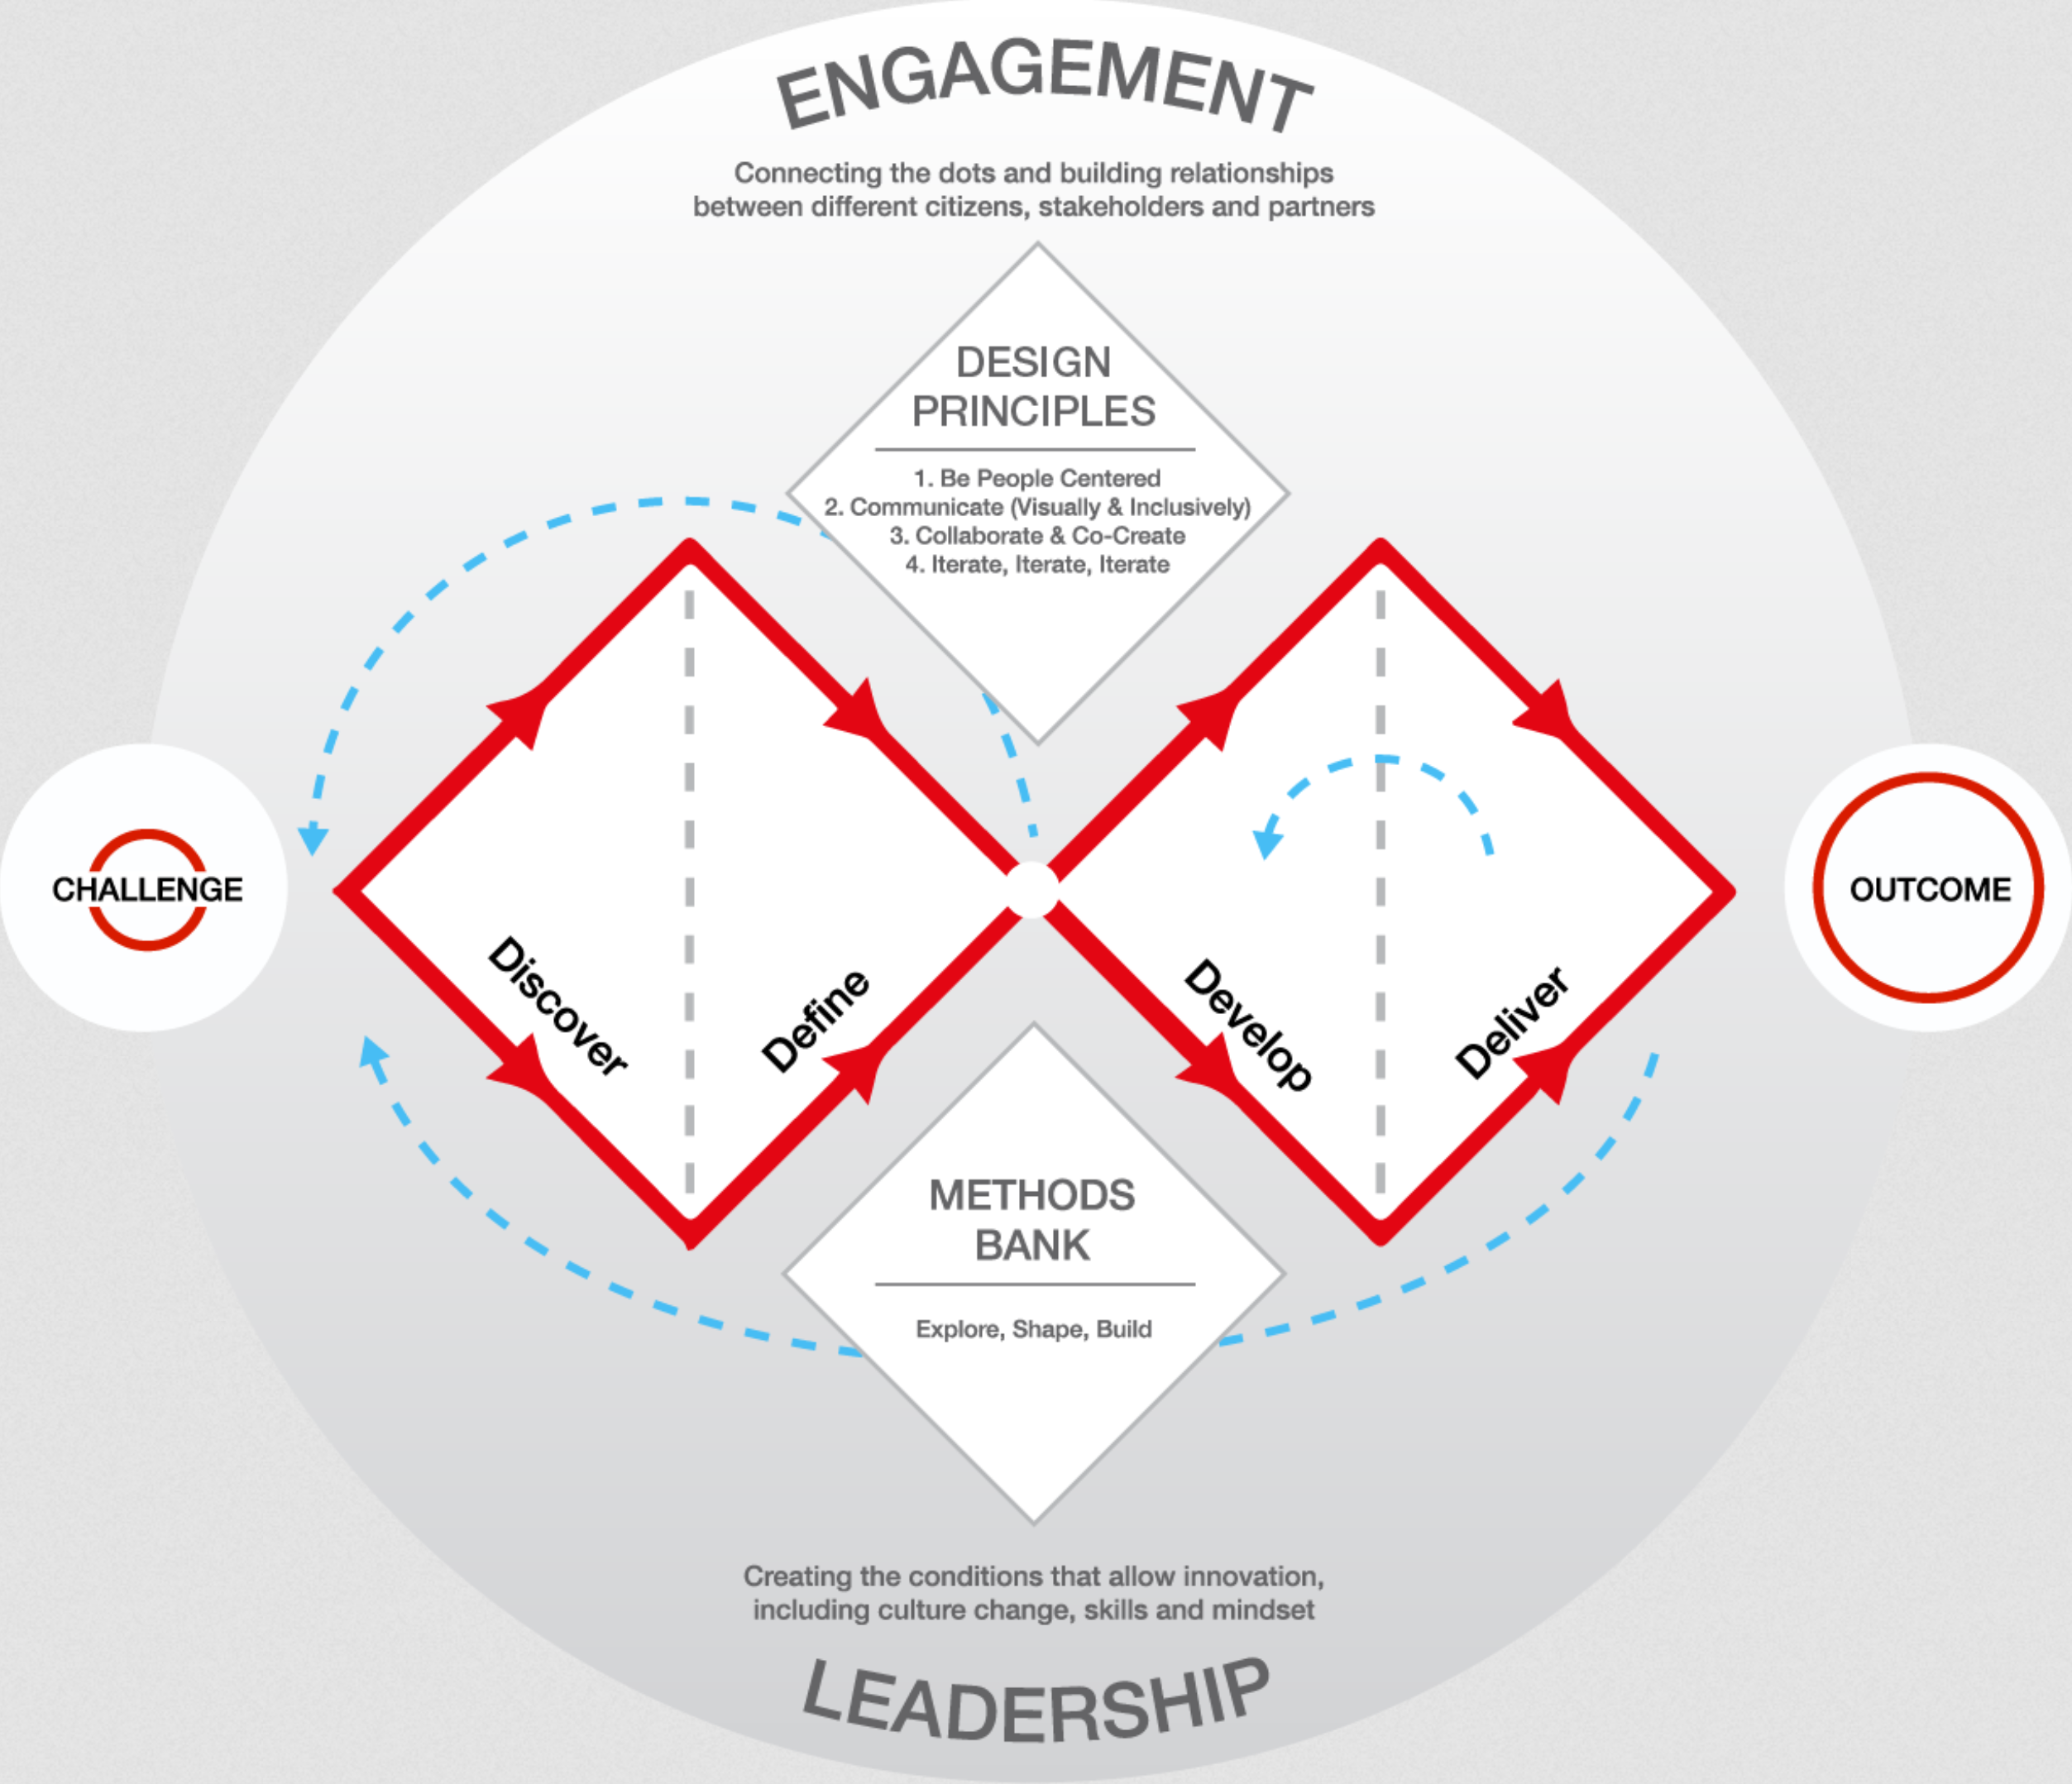
Double diamond of design
Divergent and convergent thinking
Non-linear, iterative process
Discover
Understand the problem (no assumptions); talk to people impacted by the problem
Define
Use discovered insights to define design challenge
Develop
Create different responses to design challenge (considering range of sources, insights from discover and define phases)
Deliver
Test different solutions at small scale; reject or evolve into better solutions
Adapted from https://www.designcouncil.org.uk/our-resources/framework-for-innovation/

Slide 6
DD of design supported by
Design principles
Methods bank
Characteristics of organisational culture
Explore: challenges, needs, opportunities
Shape: Prototypes, insights, visions
Build: ideas, plans, expertise

Slide 7
What is the problem space?
First phase in Double Diamond - define the problem (as in Assignment 1)
First step in ID - explore (understand) problem space to determine what to design
Why?
We know what we are aiming for (usability and good UX)
BUT
to get what we are aiming for, we need to have a clear understanding of why we are designing something
(Q2 in assignment re: Lessons)

Slide 8
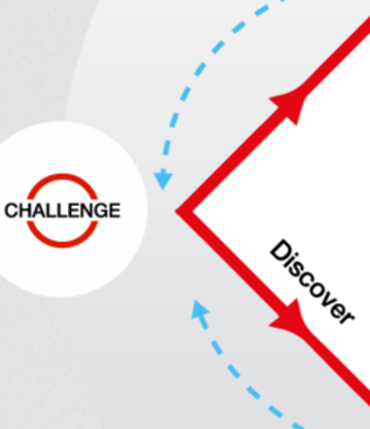
Understanding the problem space
What is wrong? Why?
Current UX and Usability (met / not met)
Context of use (ensure you read article)
What are Contexts of Use? | IxDF
How will proposed changes improve UX / meet usability goals?
In practice:
Different perspectives needed
Typically team effort (project manager; software engineer; …)
Avoid incorrect assumptions / unsupported claims
Multiple potential possibilities

Slide 9
Importance of involving users
Ensure usable product (i.e., used by users)
Actual users and stakeholders
What happens if you involve users?
Expectation management
Realistic, avoid hype
Ownership
Buy-in, contributed to design
Refer to IDEO.org Ten Year Impact Report — Process from Assignment 1

Slide 10
How much do we involve users?
How much do we need to involve users?
Fully involved targeted participants in specific tasks
Small groups (f2f) individuals thousands online
Participatory (cooperative) design
Users actively part of design
Citizen engagement
Engage population with aim to promote empowerment through technology
User involvement after product release
User reviews
A/B testing

Slide 11
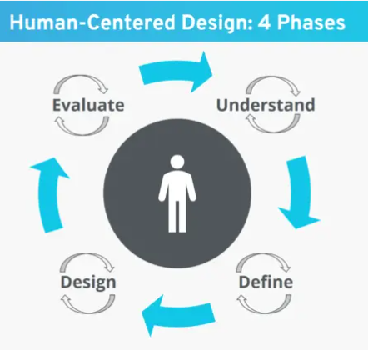
People-centred approach
Gould & Lewis three principles (1985)
Early focus on users & tasks
Who are users; what are their characteristics; context of use
Empirical measurement
Usability and UX (document, agree on, evaluate)
Iterative design
Trial and error (patience) leads to improvements
Human-centered design: Definition, use, and advantages - IONOS

Slide 12
Activities in design process
(Any) Design process
Understand requirements
Produce multiple designs
Evaluate
Basic ID activities
Establish requirements
Design alternatives
Prototype
Evaluate
Trade-offs
Balance conflicting requirements
Requires experience
Requires development and evaluation of multiple alternatives
Activities intertwined and iteratively executed

Slide 13
Activities in design process
The best way to have a good idea is to have lots of ideas
Linus Pauling
Nobel Prizes: Chemistry (1954)
Peace (1962)
(Any) Design process
Understand requirements
Produce multiple designs
Evaluate
Basic ID activities
Establish requirements
Design alternatives
Prototype
Evaluate
Trade-offs
Balance conflicting requirements
Requires experience
Requires development and evaluation of multiple alternatives
Activities intertwined and iteratively executed

Slide 14
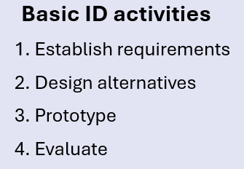
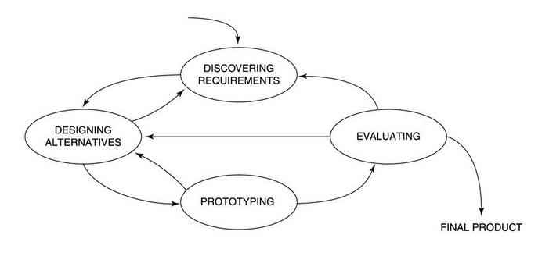
Simple lifecycle model for ID
Lifecycle & Double Diamond complementary
See https://designsprintkit.withgoogle.com/methodology/overview

Slide 15
How to find out what people need
Designers need to
Explore the problem space
Investigate potential users and their activities
Try out ideas with potential users
Focus on peoples’ goals, usability, and UX goals
Don’t expect stakeholders to articulate requirements (again, refer to IDEO.org Ten Year Impact Report — Process from Assignment 1)

Slide 16
How do you generate alternatives?
Designer “flair and creativity”
Get ideas from people with different perspectives
Apply specific methods, e.g. SCAMPER
Structured tool to initiate creative process
Encourages people to take old idea and substitute (S), combine (C ), adapt (A), modify (M), put to another use (P), eliminate (E), and reverse (R)
Other products, other domains

Slide 17
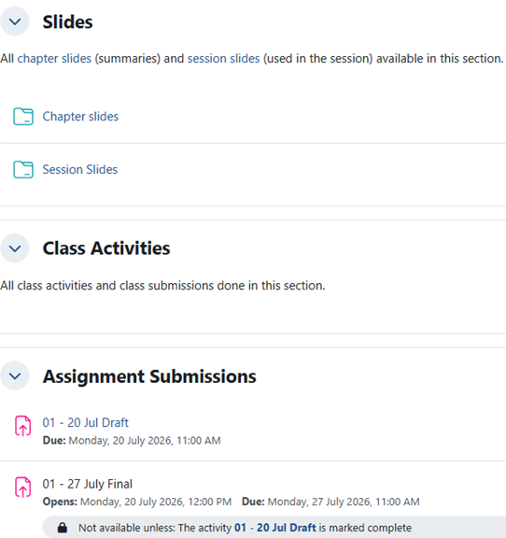
Upcoming assignments: Assignments 2 and 3
Some amendments re: Assignments 2 and 3
Questions with a specific AI-related question
Student-generated content no more than 5 pages
May apply formatting to AI-generated content to reduce volume (total will go over 5-page limit)

Slide 18
Class activity
Based on scenario, answer some questions in groups of 2 - 3
Purpose of solution
Design principle
What is wrong and why
Current usability goals (met or not) and current UX

